Slide 1
Automating Tasks
Schedule Jobs
Implement Version Control Using Git
Identify Orchestration Concepts

Slide 2
The at Command (Slide 1 of 2)
Runs a task once at a specified time.
Not designed for repetitive or regularly scheduled tasks.
You can specify a date/time or a period of time.
Usually used interactively.
Task is defined in prompt.
You can enter a path to a script or a command.
Press Ctrl+D to exit.

Slide 3
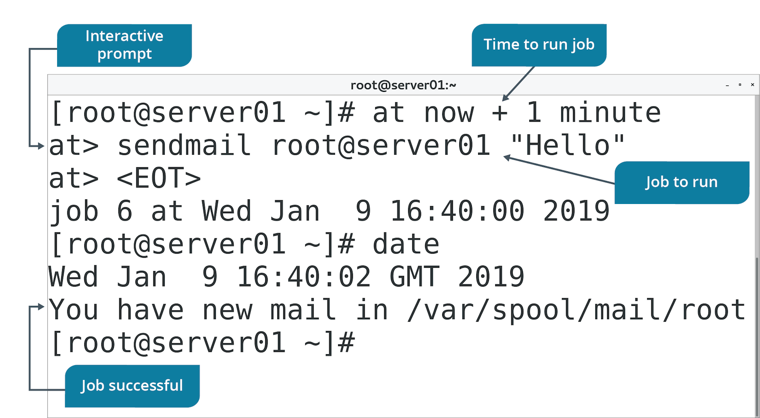
The at Command (Slide 2 of 2)

Slide 4
Cron Jobs
A scheduled task that is managed by the Linux cron daemon.
Users may want scripts or commands to execute regularly.
Automation makes tasks efficient and consistent.
cron daemon checks crontab file every minute.
Executes tasks that need to run.
Goes to sleep for a minute if there are none.
Cron jobs can specify tasks each:
Minute, hour, day, month, day of week.

Slide 5
The crontab Command (Slide 1 of 2)
Controls the cron daemon.
Assumes current user unless -u specifies other user.
Used to view, create, and delete crontab files.
Option | Used To
-e | Edit the crontab file for current user.
-l | View crontab file for current user.
-r | Delete crontab file.
-u | Create crontab file for a user.

Slide 6
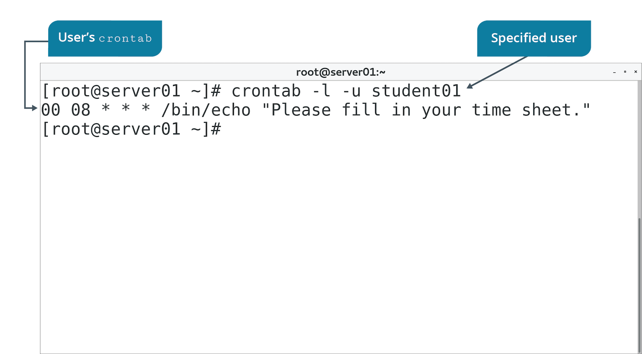
The crontab Command (Slide 2 of 2)

Slide 7
The crontab Files (Slide 1 of 2)
Define the scheduled tasks executed by cron daemon.
crontab -e opens file in default editor.
Used to specify what tasks to run and when.

Slide 8
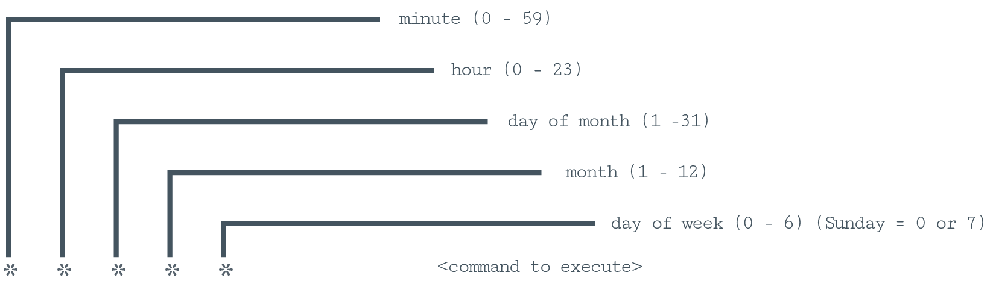
The crontab Files (Slide 2 of 2)
Example lines:
* 20 * * 1-5 /path/to/command
15 2 * * * /path/to/command
30 4 1 * * /path/to/command

Slide 9
Cron Directories
crontab files for system in /etc/cron.d/
Root can schedule system-wide tasks.
Services can schedule tasks.
Not allowed for regular users.
Root can also add to /etc/crontab
crontab files for users in /var/spool/cron/
Regular users schedule own tasks.
Executes with user's credentials.
/etc/ directory also has:
/etc/cron.hourly, /etc/cron.daily, and so on.
Some distros pre-populate /etc/crontab

Slide 10
Discussing Scheduling Jobs

Slide 11
Activity: Scheduling a Single Task
Developers need to execute a task after hours.
Schedule is not predictable.
You'll use at to satisfy this requirement.

Slide 12
Activity: Scheduling Repeated Tasks
New Develtech policy requires users to fill in time sheets.
You'll create a daily reminder.

Slide 13
Git
A distributed version control system primarily used by developers who are collaborating on projects.
Developed by Linus Torvalds.
The standard version control program in the development world.
Often integrated with development editors.
Core component is Git repository.
Storage area for code and related files.
Version control managed here.
Can be stored locally or on central repo (e.g., GitHub).
Install the git package to get started.

Slide 14
The git Command
Manages Git repositories.
Use to:
Create repo.
Add files to repo.
Commit changes to repo.
Pull down files from another repo.
And more.
Perform tasks through various subcommands.

Slide 15
git Subcommands
Subcommand | Used To
config | Set options for a repo, Git users, or global.
init | Create or reinitialize a repo.
clone | Create working copy of a repo.
add | Add files to be tracked by repo.
commit | Update repo with your changes.
status | Display status of repo.
branch | Manage branches (pointers to specific repo snapshots).
merge | Integrate changes from one branch into "master" branch.
pull | Acquire and merge changes made to other repos and branches.
push | Upload local working copy of a repo to a remote repo.
log | Display changes made to local repo.
checkout | Switch to specific branch.

Slide 16
Example Git Process for Local Repositories
Configure settings:
git config --global user.name 'User'
git config --global user.email 'user@domain.tld'
Create a directory for project:
mkdir /dev-project
git init /dev-project
Add project files to repo:
git clone /dev-project
Add project files for tracking:
git add myfile
Commit changes:
git commit -m 'Initial commit'
Retrieve status of files:
git status

Slide 17
Example Git Process for Collaboration
Pull others' changes and merge them into local repo:
git pull otherbranch
Push your changes to remote repo:
git push <remote repo> mybranch
Review what actions were taken:
git log
Switch between branches:
git checkout specificbranch

Slide 18
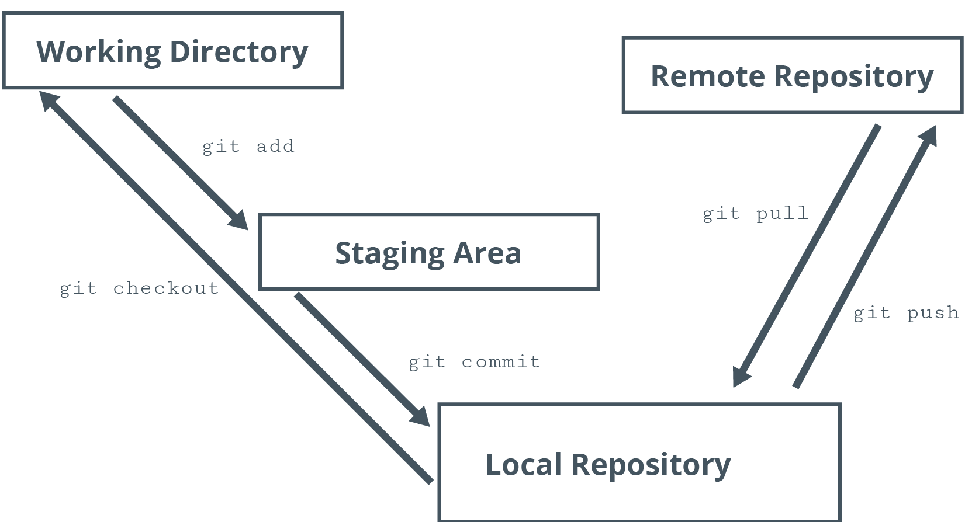
Example Git Process Flow

Slide 19
Git Files
.gitignore specifies files to ignore in commit action.
Example: Ignore README.txt
*.git/ directory contains files used to manage version control.
Location where Git stores all info.
Resides in project directory.
Created with git init command.

Slide 20
Discussing Version Control Using Git

Slide 21
Activity: Implementing Version Control Using Git
Development teams to manage different versions of code.
Multiple developers will work in conjunction on same project.
Need to minimize conflicts with code versions.
You'll set up a Git repo.
Developers will have a distributed version control system.

Slide 22
Orchestration
The automation of multiple related tasks.
Consists of an entire workflow.
Example: Web app deployment includes:
Installation/configuration of web server.
Installation/configuration of MySQL database.
Installation/configuration of app server and supporting software.
Manages each step, even though requirements may differ.
Used both on-premise and in the cloud.

Slide 23
Infrastructure Automation
Automation is accomplishing a task without human intervention.
Automation refers to a single task.
Example: Admin automates Python installation for Linux deployment.
Orchestration is a series of automation tasks.
Accomplishes large-scale deployments.

Slide 24
Build Automation
Emphasizes initial OS deployment.
Example: Using Kickstart files with RH distros.
Files referenced during installation.
OS is deployed according to file configs.

Slide 25
Infrastructure as Code
The process of configuring/deploying infrastructure through programming scripts and other code files.
Rather than through traditional software tools.
Relies on single config specification.
Used to deploy infrastructure (OS) and apps.

Slide 26
Orchestration Tools
Tool | Description
Ansible | Uses YAML files to create repeatable playbooks. Playbooks define desired config state. Agentless solution that uses SSH to deliver files.
Puppet | Uses manifest files to define infrastructure as code. Uses agents on target nodes.
Chef | Uses cookbooks to deliver config declarations. Used in cloud and on-premises.
Kubernetes | Provides container deployment/app orchestration. Kubernetes configures containers to match desired state.
OpenStack | Typically deployed as IaaS. Can orchestrate LAMP stack.

Slide 27
Procedures
Vary by solution.
Usually involve:
Defining desired config.
Delivering config to destination systems.
Processing of config.
Chef example:
Admin configures/tests "cookbook" of configs.
Cookbook is delivered to destination systems.
Chef client processes cookbook to configure nodes.

Slide 28
Attributes
Define tasks to be managed by orchestration.
Use attributes to identify specific configurations needed.
Example: OpenStack orchestration relies on attributes.

Slide 29
Inventory Management
Tools manage inventory like:
Hardware
VMs
OSes
Apps
Configurations
Different tools have different features.
Inventory is crucial because you can't manage what you don't know about.

Slide 30
Automated Configuration Management
Configures systems consistently.
More efficient build process.
Enforces security requirements.
Enforces SLAs.
More efficient change management.

Slide 31
Activity: Identifying Orchestration Concepts
Develetech is expanding into web hosting.
You've been asked to research orchestration.
Can make hosting more efficient and cost-effective.

Slide 32
Do you, or would you, consider using a version control system like Git? Why or why not?
What kind of cron jobs might you create on your Linux systems?

